Slide 1

Google Android Developer Virtual Intership
by
D.SAI PRANEETHA
Roll No. 224G1A3279
Department of Computer Science and Engineering (Data Science)
Srinivasa Ramanujan Institute of Technology
(Affiliated to JNTUA & Approved by AICTE) (Accredited by NAAC with ‘A’ Grade & Accredited by NBA (EEE, ECE & CSE)
Rotarypuram Village, B K Samudram Mandal, Ananthapuramu – 515701.
2024 - 2025

Slide 2


Contents
Google Andriod Developer virtual Internship
App Development
User Experience
Programming
Testing
Security
Performance Optimization
Continuous Learning
Integration
Learning Outcomes
GitHub Link
Queries
224G1A3279

Slide 3
What is Android Development?
Google Andriod Developer virtual Internship
Android development is the process of creating software applications
for devices that run on the Android operating system. Android is a
mobile operating system developed by Google, and it is the most
widely used operating system for mobile devices worldwide. Android
development encompasses a range of activities, including designing,
coding, testing, and deploying applications (commonly referred to as
"apps") for various Android-powered devices such as smartphones,
tablets, smart TVs, wearable, and more
224G1A3279

Slide 4
What is Android Studio?
Google Android Develepor Virtual Internship
Android Studio is the official integrated development environment (IDE) for Android app development. It is a powerful and highly specialized software tool provided by Google for developers who create applications for the Android operating system. Android Studio offers a comprehensive set of features and tools to streamline the app development process. Here are some key aspects of Android Studio:
1.Code Editing
2.User Interface (UI) Design
3.Performance Analysis
4.Version Control Integration
5.Debugger
224G1A3279

Slide 5
Introduction to programming to kotlin
Google Android Developer Virtual Internship
Kotlin is a modern programming language that helps developers be more productive. For example, Kotlin allows you to be more concise and write fewer lines of code for the same functionality compared to other programming languages. Apps that are built with Kotlin are also less likely to crash, resulting in a more stable and robust app for users. Essentially, with Kotlin, you can write better Android apps in a shorter amount of time. As a result, Kotlin is gaining momentum in the industry and is the language that the majority of professional Android developers use before diving into app creation.
224G1A3279

Slide 6
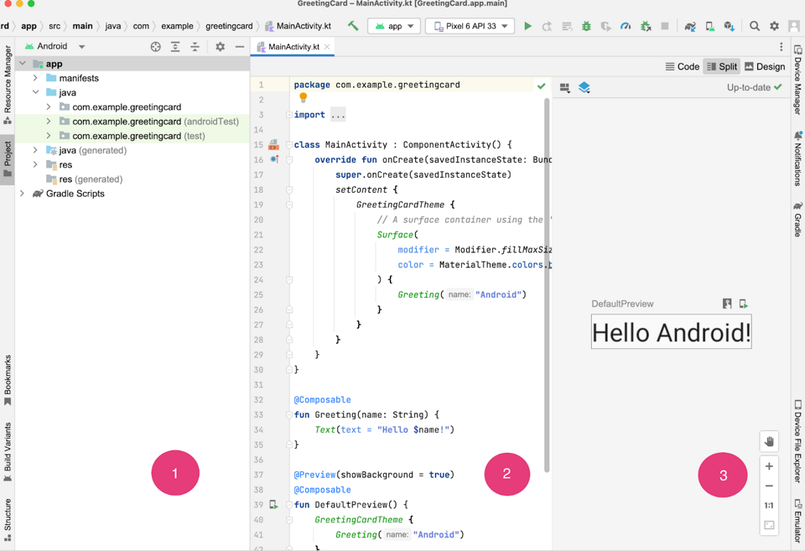
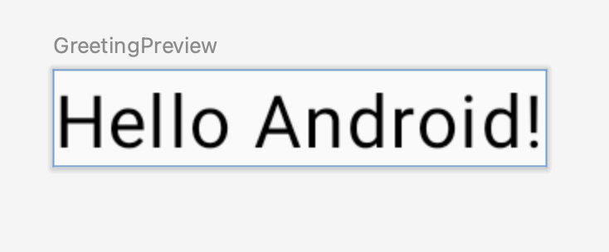
Create your first Android app
Google Android Developer Virtual Internship
In this code lab, you create your first Android app with a project template provided by Android Studio. You use Kotlin and Jetpack Compose to customize your app. Note that Android Studio gets updated and sometimes the UI changes, so it is okay if your Android Studio looks a little different than the screenshots in this code lab.
224G1A3279

Slide 7
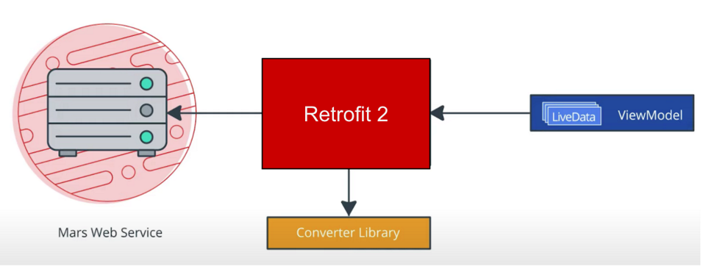
Connecting to the Internet
Google Android Developer Virtual Internship
In this task, you will add a network layer to your my Photos project that your View Model will use to communicate with the service.
224G1A3279

Slide 8
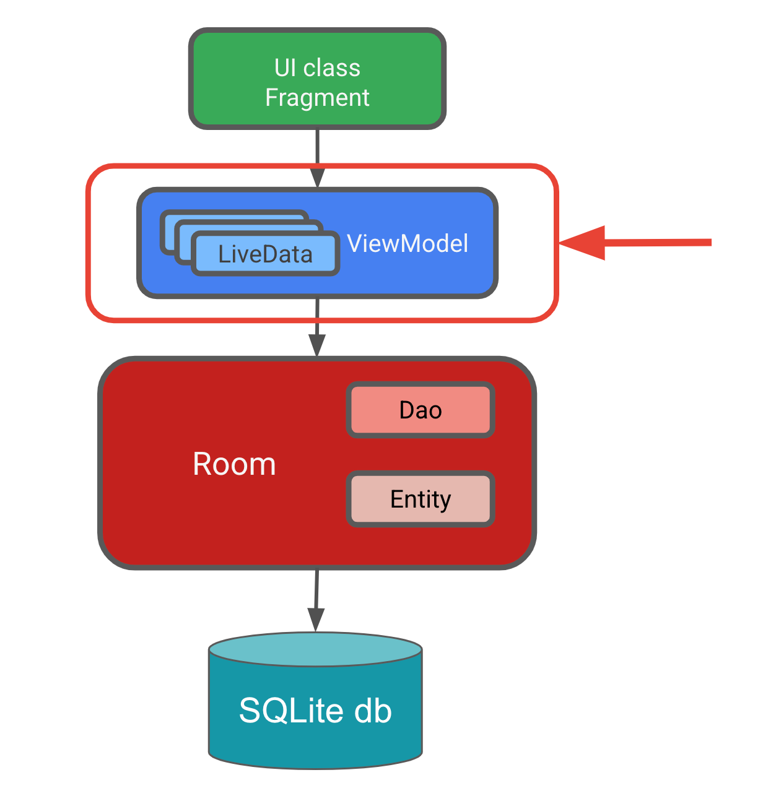
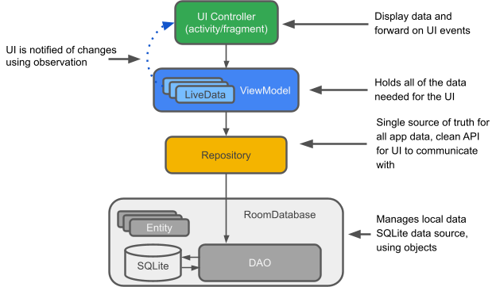
Add a View Model on Database
Google Android Developer Virtual Internship
You have thus far created a database and the UI classes were part of the starter code. To save the app's transient data and to also access the database, you need a View Model. Your Inventory View Model will interact with the database via the DAO, and provide data to the UI. All database operations will have to be run away from the main UI thread, you'll do that using coroutines and view Model Scope.
224G1A3279

Slide 9
Technologies used to make Android apps
Google Android Developer Virtual Internship
Programming Languages:
Kotlin: Kotlin has become the preferred language for Android development due to its modern features and improved developer productivity. It is fully interoperable with Java.
Java: Java was the primary language for Android development before Kotlin became popular. Many existing Android apps are written in Java.
Integrated Development Environment (IDE):
Android Studio: Android Studio is the official IDE for Android app development. It provides a comprehensive set of tools and features for designing, coding, testing, and deploying Android applications.
User Interface (UI) Design:
XML: Layouts for the user interface are often defined in XML files. Android Studio provides a visual designer for designing UI elements, and XML can be used to define the layout structure.
Emulator:
Android Emulator: Android Emulator is an official tool that allows developers to run and test their apps on virtual Android devices, simulating various device configurations and Android versions.
224G1A3279

Slide 10
Conclusion
Google Android Developer Virtual Internship
In this internship, we worked on a android app development project:-
Design a Android app for our personal experience - Creating a login Android app is a common and fundamental development project. In conclusion, here are some key takeaways:
User Authentication,User Data Management, Security, User Experience ,Error Handling
224G1A3279

Slide 11
References
Google Android Developer Virtual Internship
References:
https://developer.android.com/courses/android-basics-compose/
https://internship.aicte-india.org/
224G1A3279

Slide 12

Internship Certificate
Google Android Developer Virtual Internship
Internship Certificate:
224G1A3279

Slide 13

Google Andriod Developer Virtual Internship
Any Queries?
224G1A3279

Slide 14
Google Andriod Developer Virtual Internship
Thank You!!!
224G1A3279

